Slide 1
ThorBang MQ
erik jonsson THORén michael BANG
ASL Milestone 1

Slide 2
Agenda
Design of System
Design of Testing Setup
Summary of Experiments
4h trace
Things Learned

Slide 3
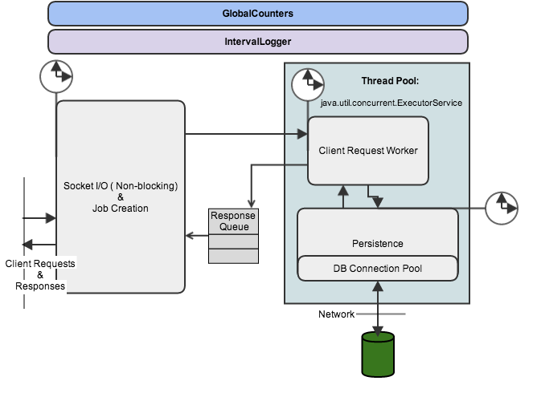

Slide 4
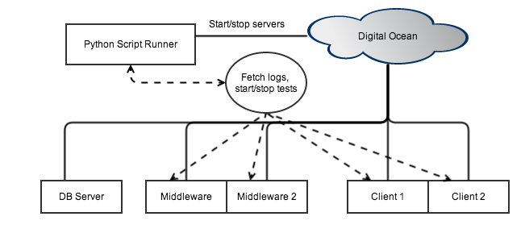
Design of Testing Setup

Slide 5
Design of System
Produced Log Files
Time since server start
Push Requests
Pop / Peek Requests
Total Requests
Total Think Time in Socket I/O and job creation
Total Think Time in Request Worker
Total Think Time in Persistence-component
593135,1101,1090,2191,47713665384,29913823472,29510444900
594136,1200,1214,2414,47829943204,30080084320,29805427278
System.nanoTime() System.nanoTime()

Slide 6
Results Of Experiments Conducted
Type of Request | Response Time [ms]
Push Message | 1.86 ± [-0.57 , 0.61]
Peek Queue | 2.02 ± [-0.67 , 0.70]
Pop Queue | 3.99 ± [-0.79 , 1.17]

Slide 7
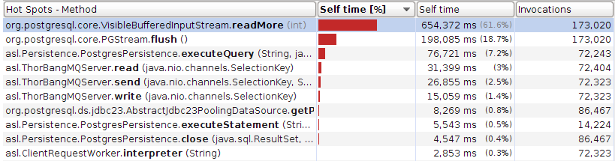
Results Of Experiments Conducted
Top 3 methods make up 87.5% of processing time for middleware

Slide 8
Results Of Experiments Conducted

Slide 9
Results Of Experiments Conducted

Slide 10
Results Of Experiments Conducted
Configuration | Mean Throughput | Response Time [ms]
10 Middlewares | 2476.3 ± 2.2 | 1.15 ± 0.01
1 Middleware | 2406.8 ± 19.1 | 44.55 ± 0.49
From 1 ➔ 10 | 3% | -390%

Slide 11
Results Of Experiments Conducted
Throughput is bounded by the minimum of the two parameters: worker threads and db-connections.
With enough db-connections: performance in bouded by db

Slide 12
4 Hour Trace
50 db-connections
50 worker threads
300 clients
Mean push: 293.91 ± [-28.91 , 21.09]
Mean pop: 1331.73 ± [-53.73 , 42.27]
Mean resp. time: 10.66 ± [-4.54 , 7.06]

Slide 13
Things Learned
A single client can on average push 225 ± 45 messages per second
Good Parameters
Worker Threads and db-connection 1:1 ratio
Worker Threads: 30-50
When thoughput hits 1500
The database is the bottleneck
Thus increasing middlewares won’t help
Maximum Throughput
Standard Test: ~ 2800 req/s
Send And Pop: ~2000 req/s
Bounded by the database

